Slide 1
Activating Historically Underrepresented Voices
Welcome!
Presented, October 2020

Slide 2
Introductions:
Name, pronouns
What interested you in this meeting today?
What potential housing policies or approaches are you most excited about?

Slide 3
History of Seattle for Everyone
In 2015 HALA started with a “28-member committee established by the mayor and city council of Seattle and tasked with devising a comprehensive response to the city’s soaring rents and home prices”
S4E brought together developers, urbanists, environmentalists, affordable housing providers, labor unions, and more in support of this consensus plan and to mobilize neighbors.

Slide 4
HALA: Objectives/Outcomes (1/2)
GOAL: 50,000 new homes, with 20,000 income-qualified affordable homes, over the next decade
MORE RESOURCES FOR AFFORDABLE HOUSING
more subsidy, through a range of revenue generating mechanisms)
MORE HOUSING
(maximizing opportunities in the market)
MORE SUPPORTS FOR COMMUNITIES
strategic preservation of housing and protections for vulnerable tenants and homeowners)
MORE INNOVATION
the streamlining of systems and related reforms to cut the costs of housing)

Slide 5
HALA: Objectives/Outcomes (2/2)
Examples:
Mandatory Housing Affordability (“MHA”), ensures all new residential developments will include a certain percentage of affordable housing units while also allowing more housing overall to be built in Seattle’s Urban Centers & Villages
Passed citywide in Spring of 2019
ADUs / DADUs, removes barriers to building accessory dwelling units, providing more housing options in every neighborhood
Ordinance passed in July, 2019 that removed occupancy requirements, removed off street parking requirements, reduced minimum lot size, increased maximum size, allowed two ADU’s on one lot, etc.
2016 Housing Levy, voter approval campaign for $290m over 7 years for homeownership assistance, homelessness prevention, and affordable housing preservation.
Still in effect
MFTE @ WA State and Seattle
Still in effect

Slide 6
Our Values
“We unite around the conviction that everyone, regardless of income or background, should have access to safe, stable, and affordable housing. We believe in a Seattle for Everyone.”
◊ Create & Preserve More Housing Options in Every Neighborhood
◊ Support Low- and Middle-Income Affordability
◊ Support Equitable Development

Slide 7
Barriers to Changing Policy (1/2)
Community organizing, “NIMBYism,” often co-opts the language of progressive groups
“Neighborhood choice,” “Community voice,” etc.
Well-funded legal challenges
esp. with SEPA appeals “anyone with $85 to spare for a filing fee and the wherewithal to make their case can appeal by arguing that the [environmental] impacts are in fact significant and merit a full review.”
Earned media onslaught (social media, shares, etc.)
The Seattle Times reported that indicated that Seattle then, with existing zoning, had more than enough zoned capacity for all the housing it would need far into the future – therefore no need for upzones at all

Slide 8
Barriers to Changing Policy (2/2)
Lobbying pressure in opposition that ultimately succeeded in reducing some of the proposed zoning changes at Council
Opponents rarely oppose the policy outright, but seek to sabotage it through amendments
MHA: Despite the new hefty fees or performance requirements put on these zones – whether the upzone was utilized or not by the builder – were widely described as “developer giveaways”
NIMBY’s opposed density, activists outside our group pushed for infeasibly high MHA fees; both would have limited policy effectiveness to meet HALA goals
Note: I’ve learned to emphasize “More housing in all neighborhoods“ to clear up that growth should happen throughout the city– NOT be concentrated in low-income neighborhoods

Slide 9
New groups of people mobilized in most neighborhoods
These “YIMBY’s” weren’t a big factor in Seattle politics previously
We had champions in government agencies and elected offices
“Policy window” through HALA
Leaders emerged in neighborhoods to self-organize for those community meetings and to advocate for “micro-issues”
“Distributed structure” in neighborhoods
S4E Organizing Assets:
Leaders & Champions
(1/4)

Slide 10
We united under shared values
Equity-based coalitions;
Growth alone isn’t enough. There must also be a greater unifying vision
Production targets were key to cohesion
Funding $$$ over time period
# of units over time period
Solutions-focused vs. strictly ideological
“what will get us to our shared goals together?”
Refocused on justice and fairness in outcomes
“What will guarantee X funding and Y units for affordable housing within Z time?”
S4E Organizing Assets:
Shared Values
(2/4)

Slide 11
Maintained diverse network; groups & individuals with shared concerns but differing philosophies
Maintain honesty about interests, forces in play, and motivations for decisions
It’s ok to disagree on some issues as long as we stay aligned on the large goals
Access to expertise from different technical backgrounds and professions
Structure: a.) Coalition & b.) Neighborhood Outreach Committee
Different constituency within Neighborhood Outreach Committee allowed people to align action with S4E goals, even if they didn’t want direct affiliation
S4E Organizing Assets:
“OK to Disagree”
(3/4)

Slide 12
Relationship building: provided chances outside of direct actions for people to get to know each other
Developed specific talking points that were distributed for each community meeting
Helped present a unified message
Encouraged people to share personal stories and experiences where possible
Provided testimony coaching and support at the meetings (emotional support + food)
S4E Organizing Assets:
Preparations
(4/4)

Slide 13
Organizing Lessons from Others

Slide 14
Six Steps to Getting Local Government Approvals (from Non-Profit Association of Northern California)
Considers Opposition for new housing and services for low-income people
No “silver bullets” but a proactive and collaborative process can yield positive results

Slide 15
Six Steps to Getting Local Government Approvals
The development team meets early to research, assess, & plan in the five key areas outlined
(1.) Organizational reputation, (2.) capacity to attract broad community support for work, (3.) previous experience in dealing with local government, (4.) opponents, and (5.) the media.
Prepare a political strategy that coordinates all your work toward getting needed votes.
Prepare a strategy to build active community support for your proposal.
Prepare a strategy to work through community concerns and deal with active opposition.
Prepare a strategy to protect and use your legal rights.
Prepare a public relations/media strategy to send your message to decision-makers and the public.

Slide 16
Common NIMBY Arguments, Community Meetings
This is the first we’ve heard about it
We fully support ___________, but just believe this is not the correct location
Why is it our neighborhood’s responsibility?
What about a ____________? Maybe a park?

Slide 17
Common NIMBY Arguments
“Development will decrease property values and higher-income earners will move”
“Development will increase crime and other undesirable activity”
“Growth will open the community up to unpalatable land uses and zoning decisions; we’ll lose the feel of our neighborhoods”
i.e. “Growth violates community will”
“Why not build further out where land is cheaper?” i.e. “Why here?”
“Development will increase traffic, overcrowding, and strain on infrastructure”
Notes:
“Development will decrease property values and higher-income earners will move”
Property Values Are Determined By Many Factors, Not By Any Single Property Nearby:
The condition of the particular property for sale,
Sales of similar properties in the neighborhood
# of properties for sale in a neighborhood,
Neighborhood amenities, such as parks, schools and transit,
Nearby large-scale commercial and industrial developments
Affordable Housing Does Not Lower Property Values How do we know? Research!
“Development will increase crime and other undesirable activity”
Affordable housing in particular can stabilized neighborhoods: if rents are affordable residents move less often. Community investment is key to safety and that can’t happen if we have high rates of displacement.
Affordable housing and denser housing also serves a wide range of people: families, students, workforce, etc.
“Growth will open the community up to unpalatable land uses and zoning decisions; we’ll lose the feel of our neighborhoods” and “Growth violates community will”
Affordable housing is designed with community in mind and fits the size, style, feel of current neighborhood.
Affordable housing can be and is often indistinguishable from other homes in the community
Most of neighborhood control through meetings is actually completely discretionary; safety, basic match to neighborhood, environmental concerns, etc. are addressed through approvals.
When we create too many discretionary burdens to housing, we can’t keep up with growth and create long-term affordability and equity problems (see: SF and SEA)
“Why not build out further out where land is cheaper?” i.e. “Why here?”
GMA + sprawl creates a higher cost for cities per capita,
problems emerge with AH when we isolate housing from opportunity and amenities
“Development will increase traffic, overcrowding, and strain on infrastructure”
Density can create walkable communities, preserve open space, and lower the cost of public services (lower per capita maintenance costs).
Many of the most desirable communities in America are dense neighborhoods.

Slide 18
Responding to a NIMBY
Educate opponents about the facts regarding feared impacts
Humanize the object of fear
Provide reassurance by respected authorities
Build relationships
Take actions to address legitimate fears

Slide 19
“Keep addressing concerns from neighbors in good faith until only unreasonable opposition remains”

Slide 20
What Other Cities have Done Successfully
Portland, OR
Minneapolis, MN
Cambridge, MA

Slide 21
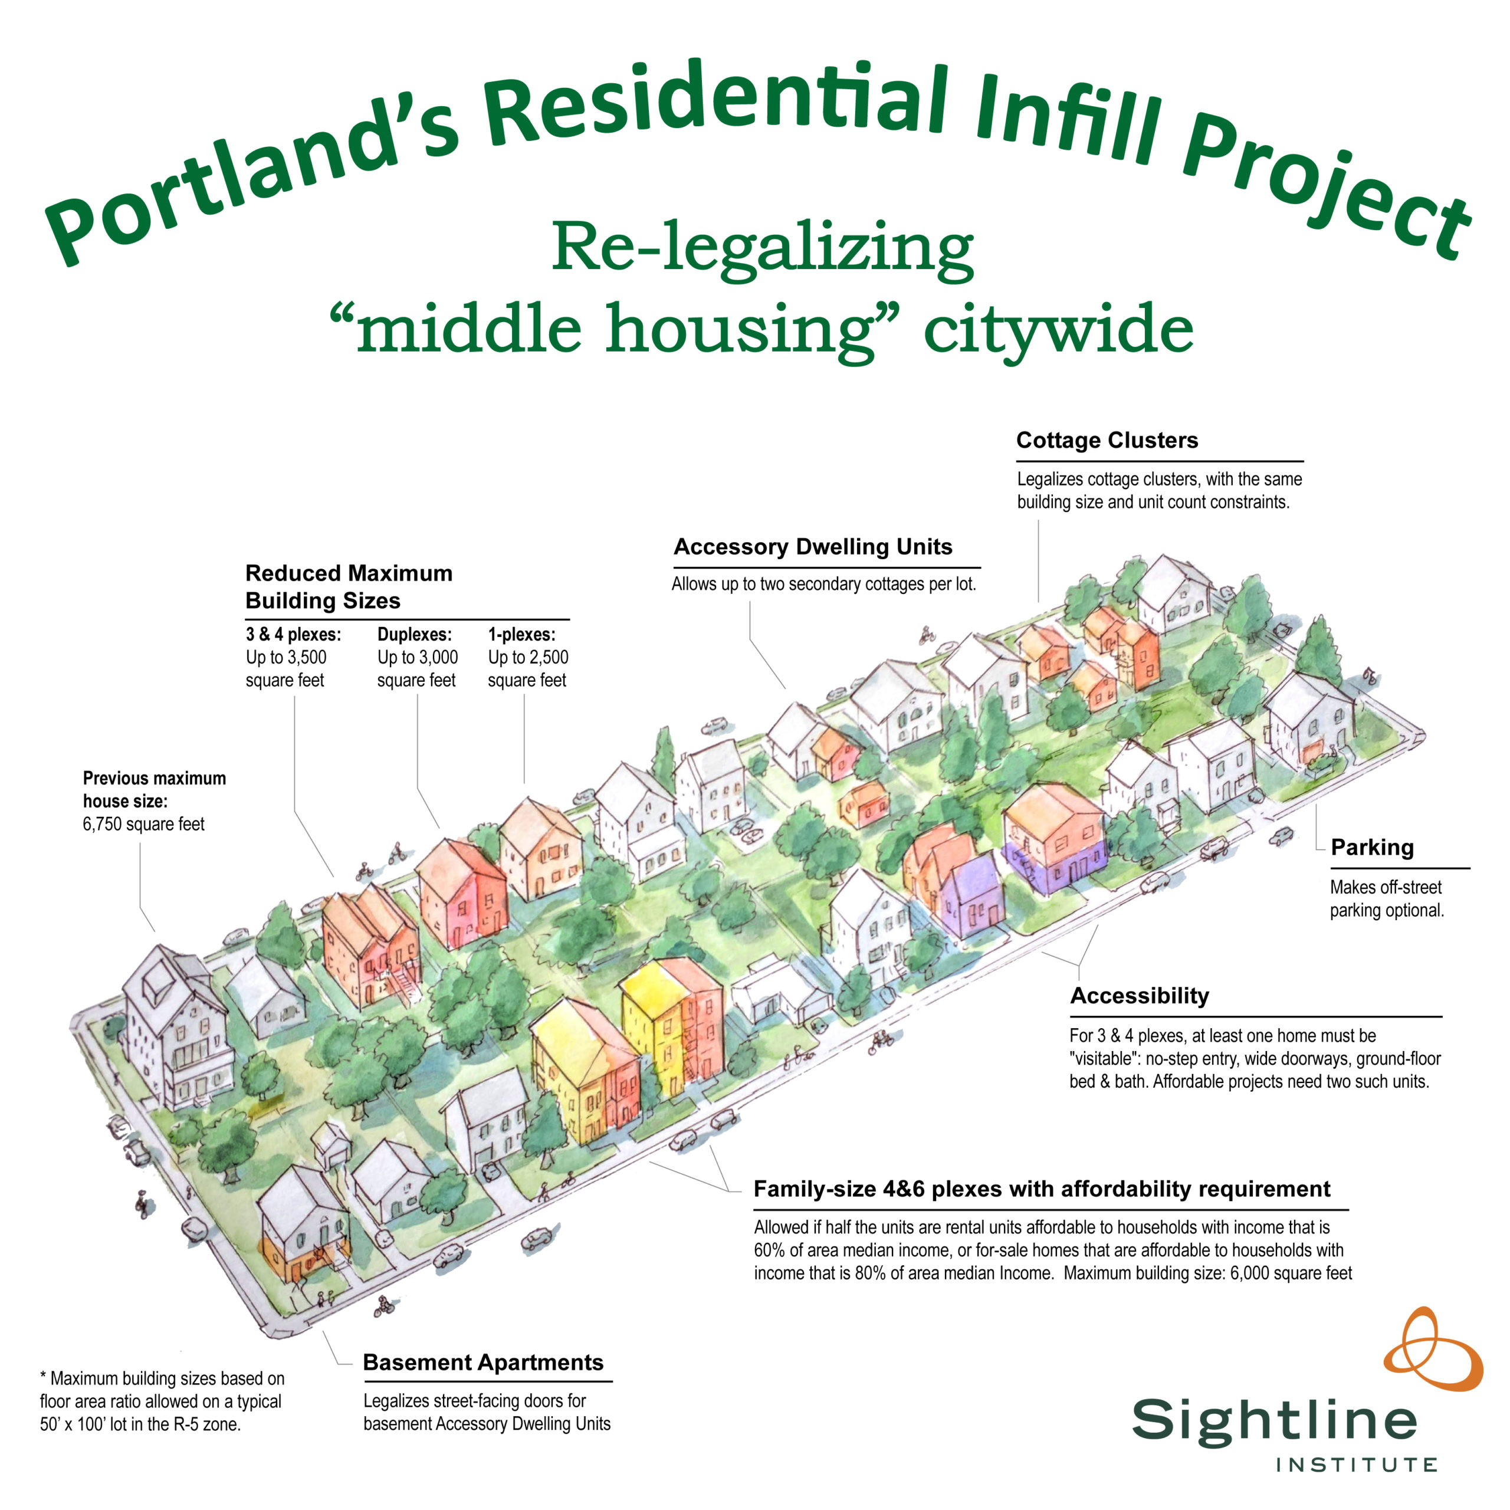
Passed: 8/12/2020
How?
+Built on state law allowing duplexes in cities >10k
+People showed up!
“6 pro-housing advocates showed up for every 1 anti-housing advocate”

Slide 22
Minneapolis 2040 Plan

Slide 23
Cambridge: Affordable Housing Overlay
AHO passed: 10/5/2020!
Problem: City was putting almost all new housing in formerly industrial areas
Now: Four story affordable apartments in all neighborhoods, with additional floors in business districts
Change the script:
“Many “progressives” defend exclusionary single-family zoning claiming that new fourplexes in affluent neighborhoods will just be “luxury” housing. But the AHO changes the politics of housing development in urban America. Now, those who say they only support “100% affordable housing” have no excuse for not passing a local version of the AHO.”
https://beyondchron.org/will-local-progressives-still-back-exclusionary-zoning/

Slide 24
QUESTIONS?
What are some of your housing and land use goals in Bellingham?
What is “the nut to crack”?
Is there a unifying value that can cohere these goals, especially beyond your group?
What organizing strength do you have already?
What strengths could you build and how?
Are there any barriers or counter-arguments that you can anticipate from opposition?
What are some possible responses?
Do you have any possible “champions” in government, community, business, non-profit, philanthropy, etc.?
Do they have any legislation or other efforts where you could find alignment and build relationship with them?

